Slide 1
Blue Trail Digital Targeting (ICP) brainstorm
GOAL: Define targeting, personas, buyer’s journey

Slide 2
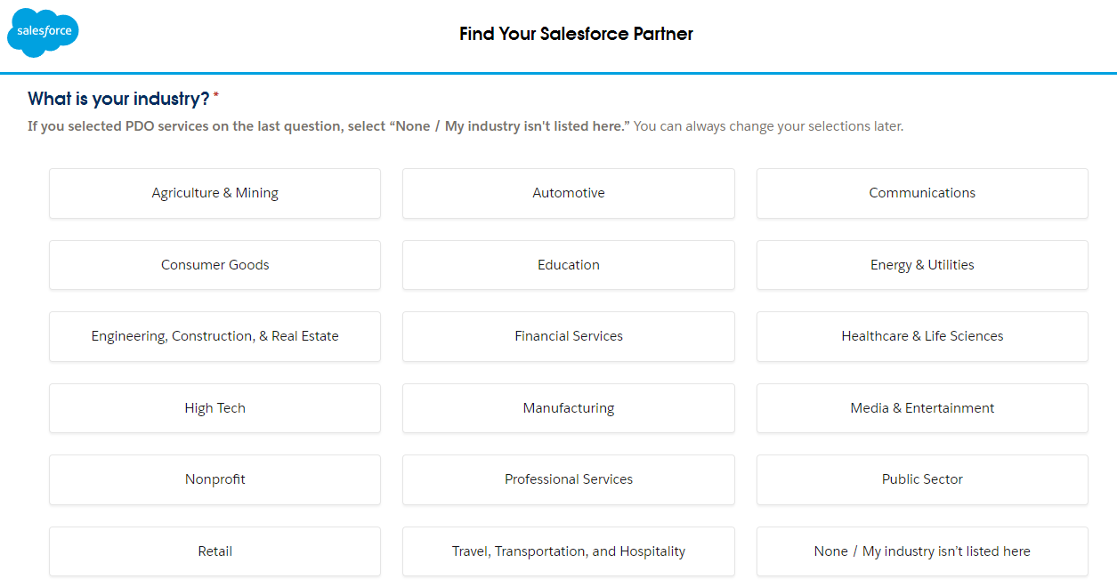
Notes:
CPG, high tech, retail, finserv, mfg, TTH, media & entertainment
Auto secondary?

Slide 3
BASIC TARGETING (ICP) – Direct outreach, COMPANY LEVEL
Your ideal client (company level) – in priority order
Industry | Size | Characteristics | Ideal Buyer | Examples
CPG | $50M+ | Should have a CMO/VP Marketing already, does work in house, spending $15-$20k/month on paid advertising, already using Salesforce CRM, already using SF marketing cloud, | CMO/VP Marketing Merchandising Lead CIO/CTO (secondary) | Pepsi, J&J, Micron, Chiobani, Simply Good, Daisy, Scrub Daddy, Lifeway, Black Rifle Coffee, Nespresso, Purina, L’Oreal, KC, Nestle/Purelife, Bayer (retail)
Retail | $250M+ | More sophisticated with marketing tech – has had marketing cloud and struggles for value, hiring | CMO/VP Marketing Merchandising Lead CIO/CTO (secondary) | Scrubs & Beyond, Underarmour, Rag & Bone, Clark’s
Financial Services (marketing focus) |  |  |  | Golden One CU, BayPort CU, Farm Credit, Mid America, Eastern Bank, First United Bank
Travel, hospitality, sports ent. |  |  |  | Ceasers, MLSE (Maple Leafs), Southwest, Marriott, Blackstone/ Turtle Bay Resorts, Trailways, Hakasan, Madison Sq Garden
High Tech
Media & Entertainment |  |  |  | Disney Plus
Manufacturing
Notes:
CPG, high tech, retail, finserv (good relationships), mfg, TTH, media & entertainment
Dan – retail, CPG content
MFG would be marketing cloud for service management
General MKTG – how salesforce transforms business

Slide 4
BASIC TARGETING (ICP) – BUYER LEVEL
Your ideal buyer(s) - who helps make the decision?
Buying committee / target titles: CMO/VP Marketing, CIO/CTO
CMO/VP Marketing
Key characteristic(s) –
Big challenges –
Role in buying process –
CIO/CTO
Key characteristic(s) –
Big challenges –
Role in buying process –
Examples of actual humans we can stalk on LinkedIn

Slide 5
Buyer's Journey / CLIENT Journey : [TARGET ICP]
 | Awareness | Consideration | Decision / Acquisition | Loyalty / Growth | Advocacy / Closure
What is the buyer thinking or feeling?
What is the buyer’s action?
What or where is the buyer researching?
Specific client/ buyer challenges / pain points
→ How will we move the buyer(s) along the journey with us in mind? →
Our opportunities / goals to add value (financial, functional, symbolic, experiential)
Client’s physical / digital / human touch points with us
Specific assets / content we have / want to build
Notes:
Awareness = learning/realizing that they need to do more than what they are doing – learning, understanding
Consideration = looking for firms like us – could they also be looking to hire internal help? What’s the alternative to us?
Decision = deciding between you and a competitor or other alternatives
Loyalty/Growth = current (or previous client)
Advocacy / Closure = wrapping up work with us, what does offboarding look like while leaving the door open?

Slide 6
Process of working with SF BD teams

Slide 7
Buyer's Journey / CLIENT Journey : Salesforce Sales REp
 | Awareness | Consideration | Decision / Acquisition | Loyalty / Growth | Advocacy / Closure
What is the buyer thinking or feeling?
What is the buyer’s action?
What or where is the buyer researching?
Specific client/ buyer challenges / pain points
→ How will we move the buyer(s) along the journey with us in mind? →
Our opportunities / goals to add value (financial, functional, symbolic, experiential)
Client’s physical / digital / human touch points with us
Specific assets / content we have / want to build
Notes:
Awareness = learning/realizing that they need to do more than what they are doing – learning, understanding
Consideration = looking for firms like us – could they also be looking to hire internal help? What’s the alternative to us?
Decision = deciding between you and a competitor or other alternatives
Loyalty/Growth = current (or previous client)
Advocacy / Closure = wrapping up work with us, what does offboarding look like while leaving the door open?

Slide 8
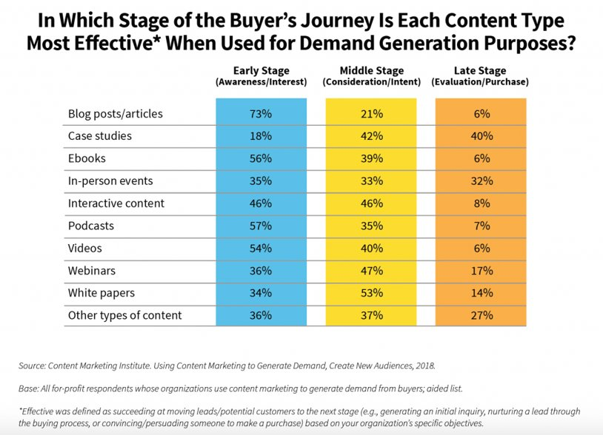

Slide 9
TARGET CLIENT PERSONA – OPTIONAL DEEP DIVE
First
Last
Goals/Metrics/Motivations Primary/secondary goals? Personal vs professional goals? Top metrics they track? Motivations?
Text
Challenges What does this person struggle with in relation to meeting goals? What serves as a roadblock for this person’s success?
Text
Background
Job
Career path
Demographics
Age
Income
Location
What can we do? ...to help our persona achieve their goals? ...to help our persona overcome their challenges?
We help you…
Technology/Social Media Device preferences? Social media platforms? Tech savvy?
1/29/2024
Notes:
Add links to LinekdIn profiles of people who fit this persona

Slide 10
TARGET CLIENT PERSONA – OPTIONAL DEEP DIVE
First Last
Common Objections
Marketing Messaging
Elevator Pitch
Why wouldn’t they buy our services? What is the alternative?
Text
How can you describe our services to have the biggest impact on our persona? What resonates most with our persona?
Text
Sell our persona on our services - in a sentence or a few words.
Text
Notes:
Main Messaging Elements Summary:

